Slide 1
Beijing Inbound Tourist Service Optimization System Construction Plan
2026/07/31
汇报人：零分贝

Slide 2
目录
Project Background: Booming Inbound Tourism Market and Service Gaps
Core Service Challenges and Targeted Solutions
01
02
CONTENTS
Project Strategic Value: From Service Upgrade to Global Image Enhancement
03

Slide 3
Project Background: Booming Inbound Tourism Market and Service Gaps
01

Slide 4
China's Visa-Free Policy Expansion Drives Inbound Tourist Growth
38-Country Visa-Free Entry Policy Implemented
Covers nationals from 38 countries, simplifies short-term entry procedures, and significantly lowers traditional visa application barriers
25 Mutual Visa Exemption Agreements in Force
Bilateral visa-free agreements signed with 25 countries, allowing citizens of contracting parties to enter and exit with passports without prior visa applications
240-Hour Transit Visa-Free Policy Launched
Transit stay duration extended from 72/144 hours, covering 60 ports in 24 provinces, supporting 10-day cross-city in-depth tours
2025 Inbound Market Growth Trend
Q1 2025 saw 9.215 million foreign inbound tourists, up 40.2% year-on-year, showing strong growth momentum

Slide 5




Beijing as the Core Hub for Inbound Tourism
2024 Beijing Inbound Tourist Volume
Received 3.942 million inbound tourists in 2024, up 186.8% year-on-year, recovering to 85.1% of the 2019 level
Inbound Tourist Structure and Source Markets
Foreign tourists account for 81.5% of the total, reaching 3.213 million, with core source countries including the United States, Russia, Malaysia, etc.
Tourism Foreign Exchange Revenue Performance
Generated 4.91 billion USD in tourism foreign exchange revenue in 2024, up 151.7% year-on-year, with significant local economic driving effect
Prominent Service Shortcomings
Tourist volume nearly doubled, but supporting service facility upgrades lagged, with six core service gaps directly affecting tourist experience

Slide 6
Core Service Challenges and Targeted Solutions
02

Slide 7



Challenge 1: Prominent Payment Scenario Barriers
Payment Pain Point Survey Results
2024 survey of inbound tourists in Beijing shows 40% of respondents hope to add commonly used mobile payment methods
Poor Self-Service Terminal Experience
Another 40% of respondents propose optimizing self-service terminal interfaces to reduce operation difficulty
Insufficient Payment Method Compatibility
Complex procedures for binding overseas credit cards to mobile payment, small merchants only support domestic mobile payment, cash usage scenarios are limited

Slide 8



Solution 1: Multilingual Payment Assistance Terminals
Core Function Design
Supports multilingual interfaces, real-time translation, compatible with existing POS systems, covering international credit cards, foreign card-bound mobile payment, cash exchange services
Phased Deployment Plan
Phase 1 (1st month): covers two major airports and 10 core scenic business districts; Phase 2 (3rd month): covers all 3A+ scenic spots and 65 business districts in the city
Priority Coverage Scenarios
Key deployment at Capital Airport, Daxing Airport and core tourism hubs with high tourist concentration, accurately reaching target users

Slide 9
Expected Outcomes of the Payment Solution
Pilot Verification Effect
01
Airport payment service centers have served nearly 3,000 overseas tourists since February 2024, completing over 103,000 transactions, proving the model feasibility
Efficiency Improvement Target
02
Expected to reduce payment time by 60%, significantly lower transaction friction for tourists, and boost consumption willingness and satisfaction
Strategy Adaptability
03
The combined strategy of "large-amount card payment, small-amount QR code payment, cash as backup" adapts to payment needs in different consumption scenarios

Slide 10
Challenge 2: Communication Barriers in Pharmacy Purchases
01
Paradox of Drug Purchase Channel Selection
60% of tourists prefer offline drug purchases to verify drug information, but 40% switch to online channels due to communication and payment issues
02
Severe Language Barriers
80% of foreign tourists encounter language barriers when purchasing drugs, with differences in accent, speech rate and professional terms leading to communication errors
03
Medication Safety Risks
60% of tourists cannot clearly understand drug usage, dosage and side effect instructions, posing medication safety risks

Slide 11



Solution 2: AI Pharmacy Communication Assistant
Core Functions
Deployment Method
Implementation Timeline
Supports real-time voice translation for medical scenarios, photo recognition of overseas drugs to match domestic equivalents, multilingual symptom templates and first aid guidelines
Covers large chain pharmacies and hospital outpatient pharmacies in Beijing, with a synchronized WeChat Mini Program for tourists to access anytime
Pilot at 50 pharmacies in Chaoyang and Haidian districts in the 2nd month, complete full deployment at over 300 pharmacies citywide in the 4th month

Slide 12

Expected Outcomes of the Pharmacy Solution
Quantitative Efficiency Improvement Target
Expected to reduce repeated drug purchase errands by 70%, cut first-time purchase communication time by 80%, and improve drug purchase efficiency
Real User Verification
A French user with thyroid disease previously needed 2 years to independently complete medical visits and drug purchases, but can now manage medication and check contraindications autonomously with the AI assistant
User Feedback
Tourists comment the tool "has no language barriers, provides bilingual instructions, and responds patiently", with high satisfaction

Slide 13

Challenge 3: Poor Catering Ordering Experience
Language and Information Barriers
80% of tourists encounter language barriers and menus without pictures when ordering, leading to high order error rates and poor experience
Insufficient Taste Adaptability
Average spiciness of Beijing restaurants is 28% higher than tourist preferences, dietary restriction needs are often ignored due to poor communication
Urgent Adaptation Demand
Spiciness preference gap reaches 0.66 points, 40% of tourists list language barriers as the top pain point in ordering scenarios

Slide 14

Solution 3: Visual Bilingual Menus and Dietary Communication Toolkit
Core Function Design
Chinese-English bilingual menus with real dish photos, 0-5 level spiciness labels, allergen and dietary restriction icons, supporting "point-to-order" operation
Coverage Scenarios
Covers over 500 restaurants in tourist gathering areas such as Wangfujing, Qianmen, Nanluoguxiang, with synchronized access to food delivery platforms
Implementation Timeline
Complete pilot at 100 restaurants in the 1st month, achieve full coverage of 500 partner restaurants in the 3rd month

Slide 15

Expected Outcomes of the Ordering Solution
Pilot Verification Effect
Pilots in Shanghai and Shenzhen show bilingual menus can significantly improve ordering speed, allowing self-service ordering without additional translation assistance
Efficiency and Experience Target
Expected to reduce ordering time by 50%, completely eliminate dietary restriction communication errors, and reduce spiciness matching error to 0
User Feedback
Pilot restaurants report foreign tourists can clearly identify dish names and tastes, solving previous communication difficulties

Slide 16

Challenge 4: Inconsistent English Service Scripts for Service Staff
Insufficient Service Consistency
Lack of standardized service scripts leads to inconsistent responses to the same question from different volunteers, reducing tourists' trust in services
Differences in Communication Preferences
50% of tourists prefer short sentence responses, 50% accept long sentences, 60% do not need repeated confirmation, with high requirements for communication efficiency
Differences in Information Channels
60% of tourists rely on social platforms for information, 40% rely on official channels, so service scripts need to adapt to both information styles

Slide 17
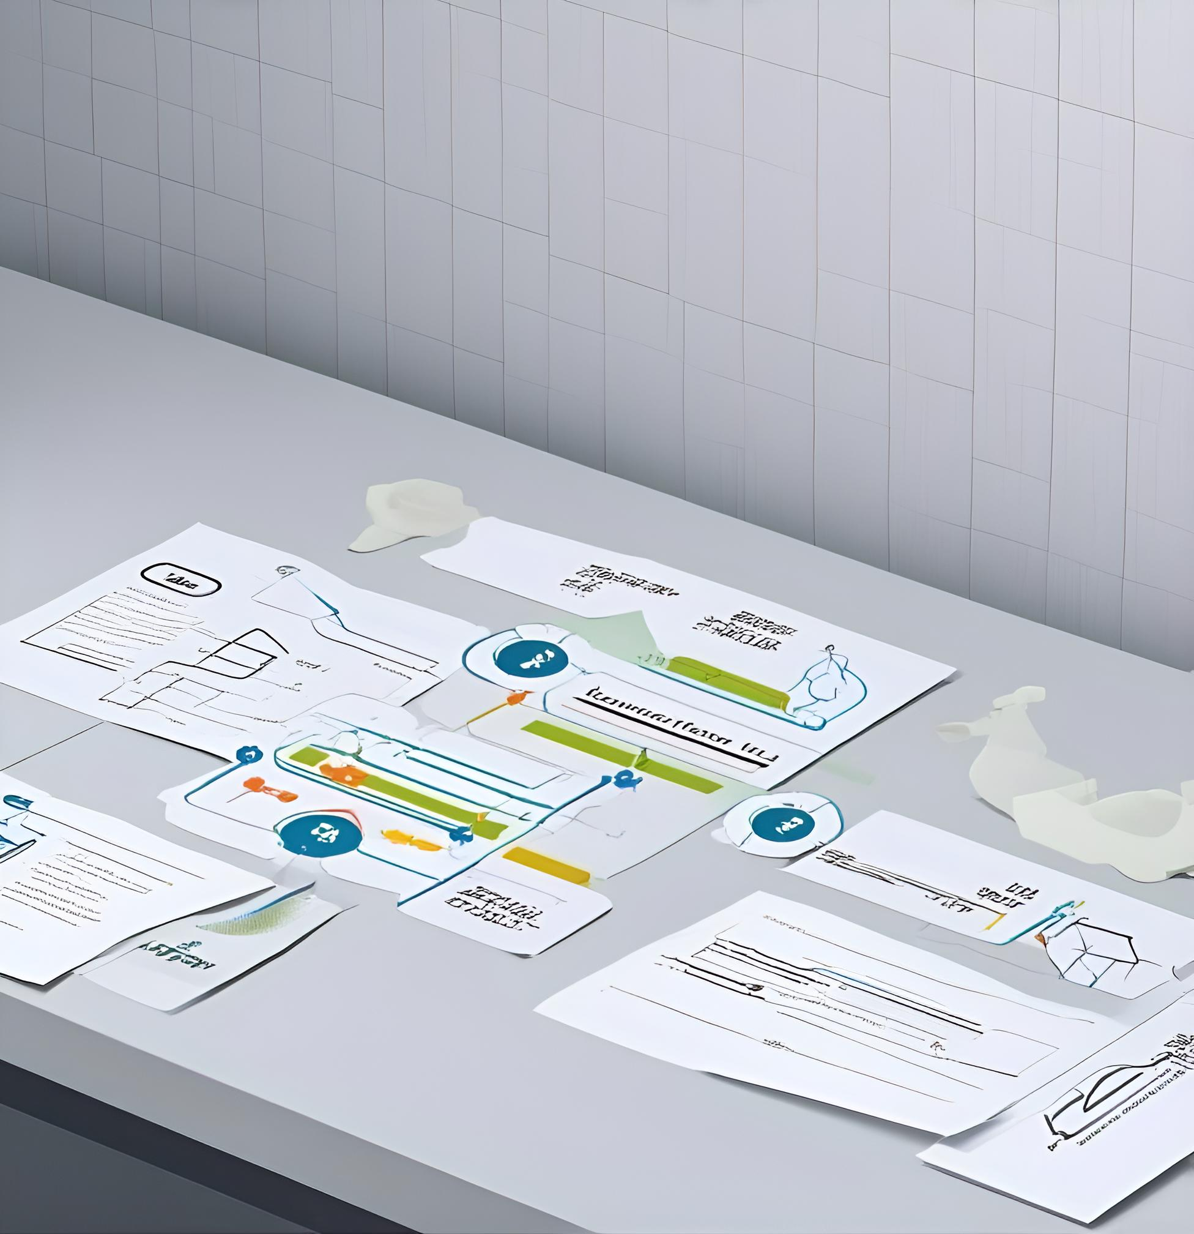
Solution 4: Standardized English Service Scripts and Training Package
Core Content
Modular scripts covering five scenarios: catering, pharmacy, hotel, transportation and emergency, with supporting pronunciation guides, audio samples and cultural considerations
Implementation Method
Distributed to over 300 service venues through WeChat Mini Program and paper manuals, covering frontline service staff
Promotion Timeline
Complete script development in the 1st month, complete training for 1,000 service staff in the 2nd month, achieve full deployment in the 3rd month

Slide 18
Expected Outcomes of the Service Script Solution
Pilot Verification Effect
Coverage Target
Standardization Target
After the Fengtai multilingual service portal was launched in March 2025, it served more than 2,000 foreign users in 7 months, reducing communication confirmation time by 80% and information error rate to below 5%
Covers three core languages: English, Japanese and Russian, meeting over 90% of foreign-related service needs, with Arabic available on demand
Expected to achieve standardized service scripts in 90% of core tourism service venues in Beijing, improving service consistency

Slide 19
Challenge 5: Poor Emergency Assistance Response
Prominent Emergency Scenario Contradictions
Language barriers and unfamiliarity with procedures make it difficult for short-stay tourists to get help quickly in emergency situations
User Characteristic Adaptation Demand
60% of tourists stay for less than 1 month and do not need long-term adaptation solutions, requiring efficient instant emergency support
Information Reliability Risk
80% of public information has varying degrees of deviation, and tourists are prone to get wrong guidance in emergencies, exacerbating risks

Slide 20
Solution 5: 24/7 Multilingual Emergency Assistance Hotline and Application
Core Functions
Supports real-time translation, location-based emergency guidance, one-click connection to multilingual agents of 110/120/119, with supporting AI first aid guidelines and 24-hour pharmacy location
Implementation Method
Launches independent APP and WeChat/Alipay Mini Programs, widely promotes QR codes at transportation hubs, hotels and tourist centers
Promotion Timeline
Complete application development in the 1st month, pilot at two major airports in the 2nd month, achieve citywide coverage in the 3rd month

Slide 21
Expected Outcomes of the Emergency Solution
Pilot Verification Effect
Efficiency Improvement Target
Reliability Guarantee
An American tourist with a feverish child received instant care guidance using the AI tool, a Russian user read medical reports through AI translation, reducing repeated hospital visits
Expected to reduce emergency communication time by 80%, cut emergency response time by 75%, with a first-help resolution rate of over 90%
Information error rate is controlled below 5%, ensuring accurate and reliable information in emergency scenarios

Slide 22

Challenge 6: Insufficient Depth of Tourism Guidance Information
Unmet Demand for In-Depth Experience
60% of tourists hope to access niche local routes, real-time scenic spot passenger flow and surrounding service information, which cannot be covered by existing platforms
Insufficient Information Trust
80% of tourists report that online information has deviations, making it difficult to filter authentic and useful tour and service information
Tourist Behavior Characteristics
100% of surveyed tourists obtain information through social platforms, preferring lightweight and practical digital guidance tools

Slide 23

Solution 6: Beijing Micro Guide AI Personalized Tour Assistant
Core Functions
Multilingual real-time personalized recommendation, covering local resident-curated niche routes, real-time scenic spot passenger flow, surrounding service query, dietary preference screening
Implementation Method
Launches WeChat Mini Program and independent APP, posts QR codes at scenic spots, hotels and transportation hubs for tourists to scan and use
Promotion Timeline
Complete content integration in the 1st month, launch 100 local routes for pilot in the 2nd month, launch 500+ routes and real-time data functions in the 3rd month

Slide 24

Expected Outcomes of the Micro Guide Solution
Market Demand Verification
The hashtag #ChinaTravel on overseas social platforms has over 1 billion views, proving strong demand for in-depth tour content among overseas users
Efficiency and Experience Target
Expected to improve tourist satisfaction by 30%, drive a 20% increase in visits to non-popular scenic spots, and extend tourist stay duration
Pilot Verification Effect
The Fengtai pilot served more than 2,000 foreign users in 7 months, reducing information query communication time by 80%, proving the model feasibility

Slide 25
Project Strategic Value: From Service Upgrade to Global Image Enhancement
03

Slide 26




Threefold Strategic Value of Service Upgrade
Economic Growth Engine
Extension of Diplomatic Goodwill
Inbound tourism consumption directly drives foreign exchange revenue and local economic growth, with Beijing's tourism foreign exchange revenue reaching 4.91 billion USD in 2024, service upgrade can further release consumption potential
Open policies such as visa exemption release diplomatic goodwill, service quality determines policy effect, directly affecting international community's favor and trust in China
Cultural Communication Carrier
Value Transmission Logic
Positive experiences of tourists will form spontaneous overseas dissemination, every high-quality service is part of people-to-people diplomacy, which can shape China's international image at scale
Service upgrade → improved tourist satisfaction → spontaneous positive publicity → improved international favor →助力 people-to-people diplomatic relationship development

Slide 27
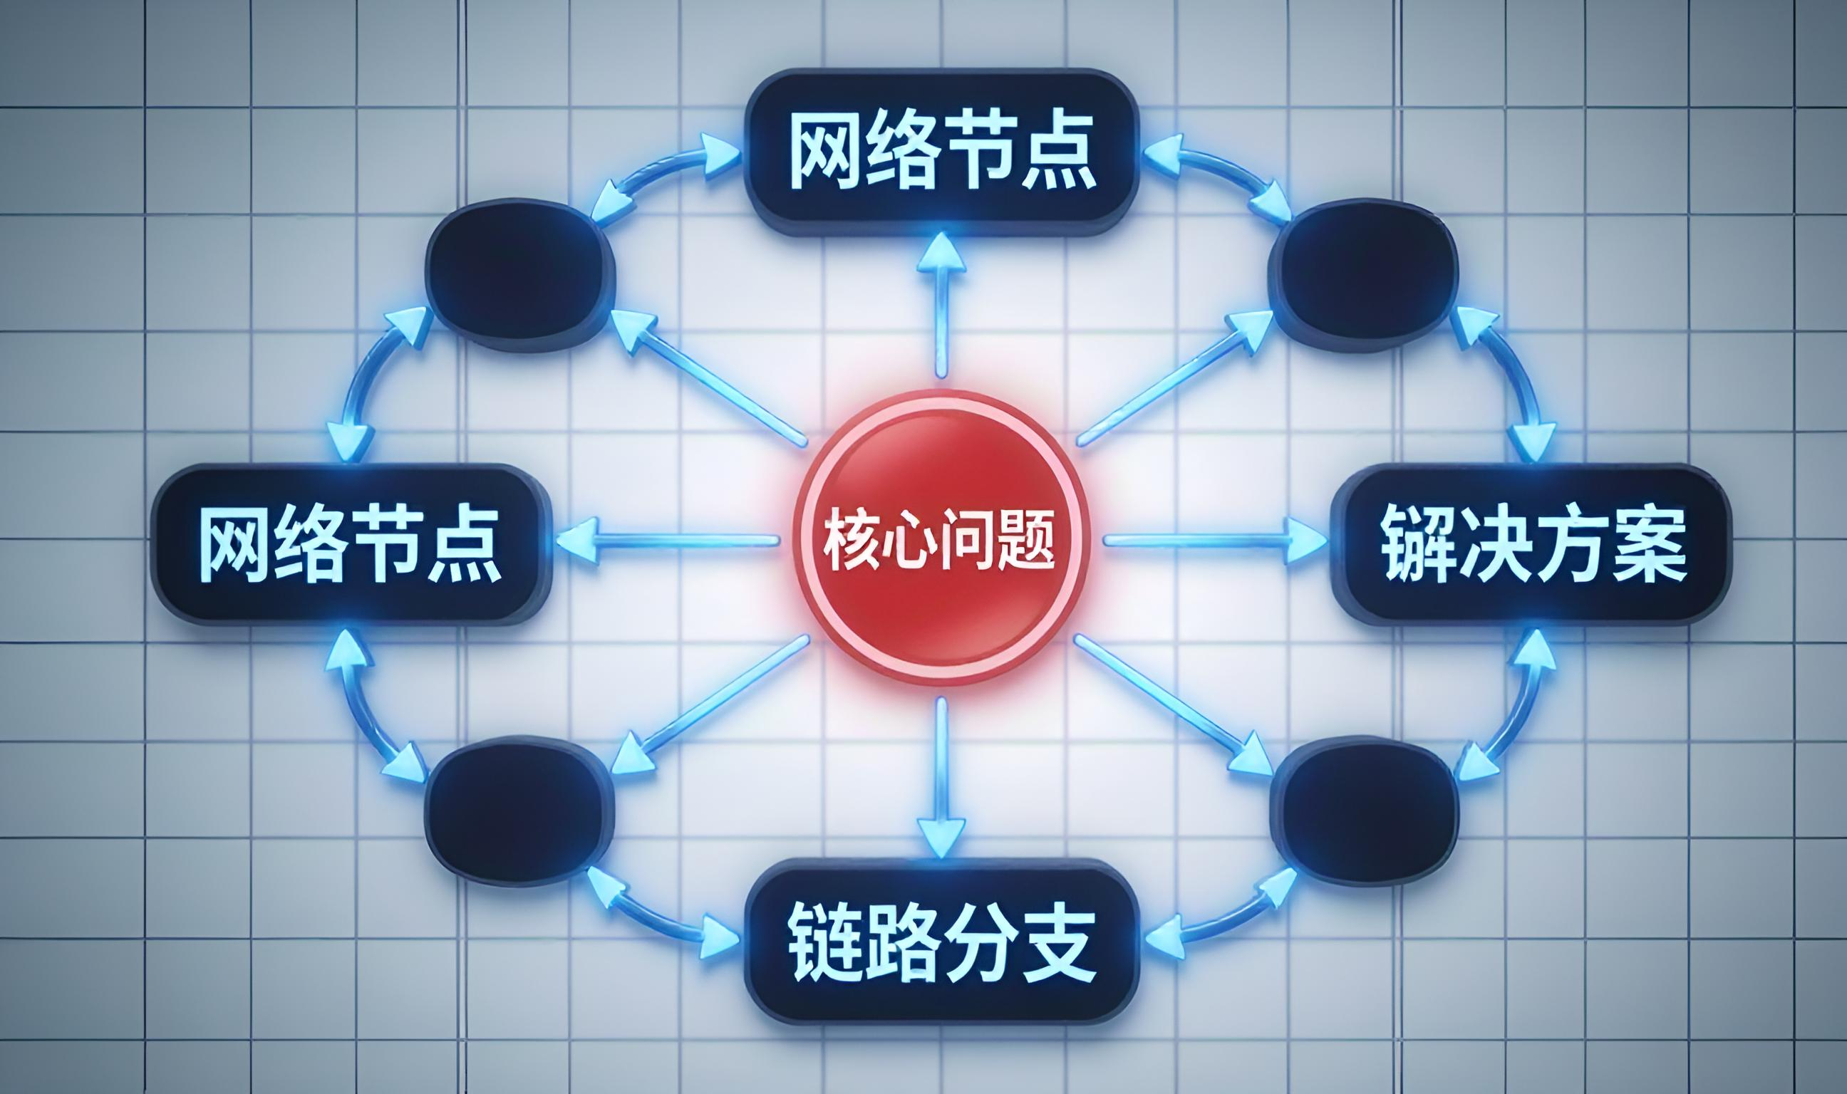


Project Summary and Acknowledgments
Core Project Logic
Team Philosophy
Acknowledgments
Focusing on six core service pain points of Beijing's inbound tourists, build a full-scenario service system through technology + process upgrade, achieving dual improvement of tourist experience and city image
Every minor service optimization can become a business card of China's international image, and every participant's effort has unique value
Thank the advisors and team members for their support, welcome questions and exchanges from the judges

Slide 28
谢谢
THE END

